Slide 1
GAN and Feature Representation
Hung-yi Lee

Slide 2
Outline
Generator
(Decoder)
Discriminator
Encoder
+
GAN+Autoencoder
InfoGAN
BiGAN
Encoder
Generator
(Decoder)
Discriminator
x
z
x
scalar
Generator
(Decoder)
Discriminator
Encoder
z
x
scalar
z
z
Decoder
x
x
Discriminator
scalar
x
Encoder
z
z

Slide 3
GAN + Autoencoder

Slide 4
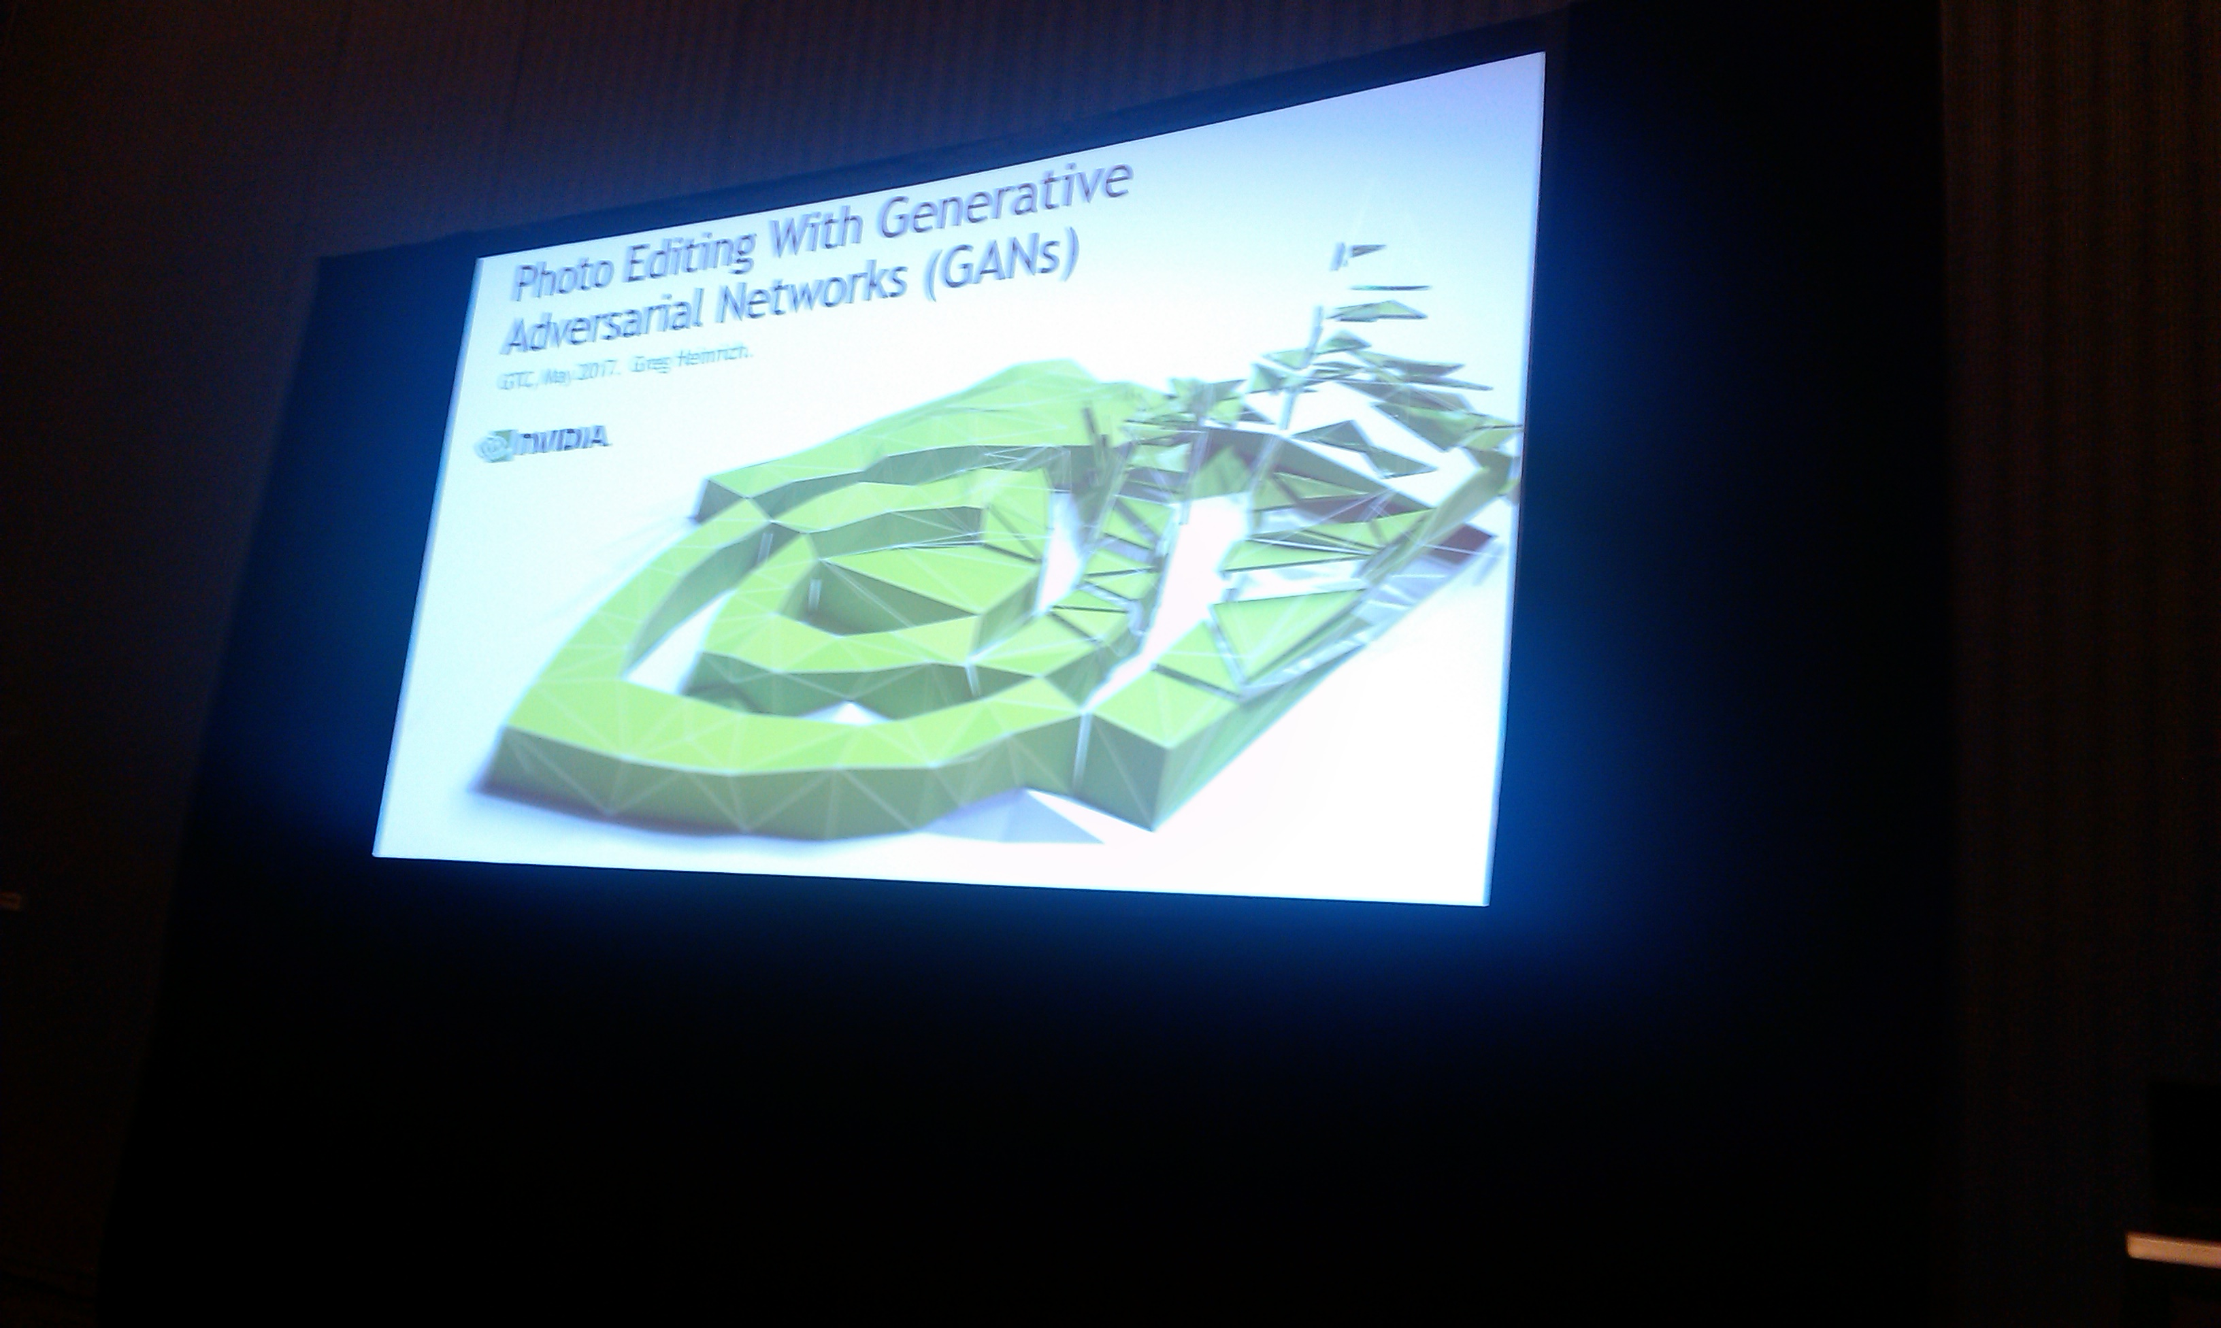
Photo Editing
https://devblogs.nvidia.com/parallelforall/photo-editing-generative-adversarial-networks-2/
Notes:
Every one knows GAN
Play a game at the beginning

Slide 5
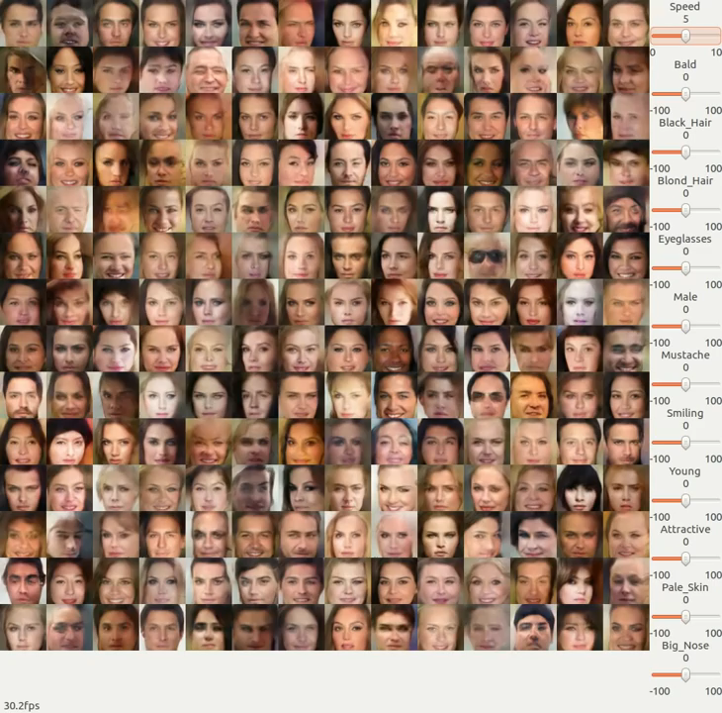
Photo
Editing
Generator
(Decoder)
z
x
We can tune z to edit image x
How to modify a specific attribute?
https://www.youtube.com/watch?v=kPEIJJsQr7U

Slide 6
GAN+Autoencoder
We have a generator (input z, output x)
However, given x, how can we find z?
Learn an encoder (input x, output z)
as close as possible
Encoder
Generator
(Decoder)
x
z
x
different structures?
init
fixed
Discriminator
Autoencoder
Notes:
En and dis have difference structure?

Slide 7
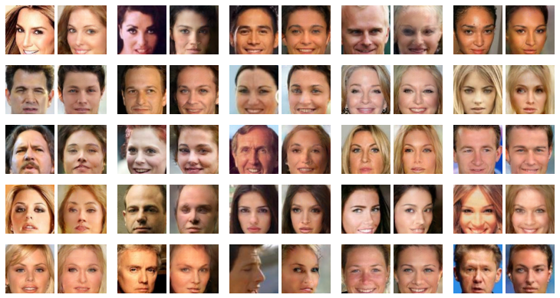
as close as possible
Encoder
Generator
(Decoder)
x
z
x
Notes:
Usually become female faces?

Slide 8
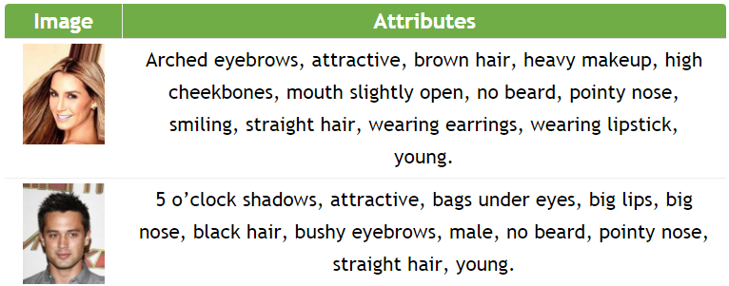
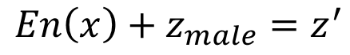
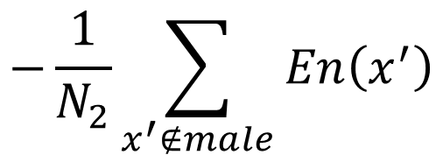
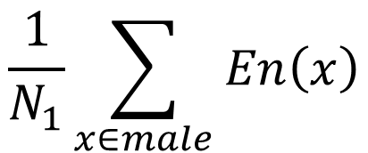
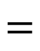
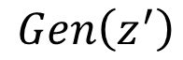
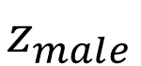
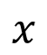
Attribute Representation
CelebA
$$\frac{1}{N_{1}}\sum_{x∈male}{En\left(x\right)}$$
$$−\frac{1}{N_{2}}\sum_{x^{′}∉male}{En\left(x^{′}\right)}$$
$$z_{male}$$
$$=$$
Female
image
male
image
$$x$$
$$En\left(x\right)+z_{male}=z^{′}$$
$$Gen\left(z^{′}\right)$$
Notes:
Need a figure

Slide 9
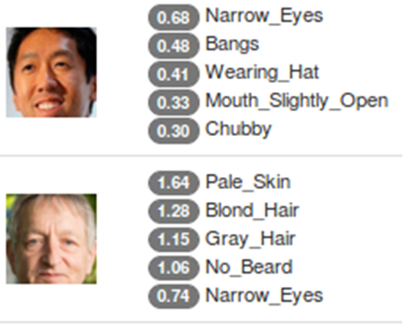
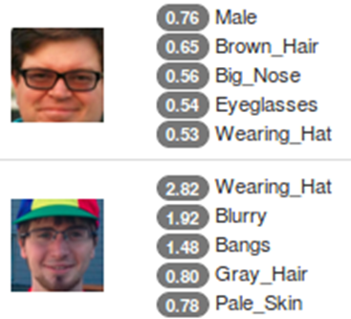
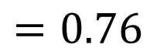
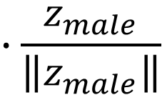
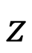
Find the Attributes
$$z$$
$$∙\frac{z_{male}}{\left\|z_{male}\right\|}$$
$$=0.76$$

Slide 10

https://www.youtube.com/watch?v=9c4z6YsBGQ0
Jun-Yan Zhu, Philipp Krähenbühl, Eli Shechtman and Alexei A. Efros. "Generative Visual Manipulation on the Natural Image Manifold", ECCV, 2016.

Slide 11
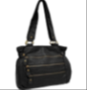


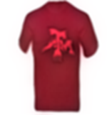
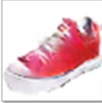
Basic Idea
space of z

Slide 12
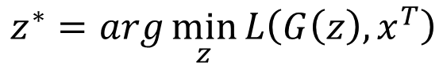
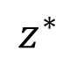
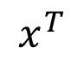
Back to z
$$z^{∗}$$
$$x^{T}$$
Method 1
Method 2
Method 3
$$z^{∗}=arg\min_{z}{L\left(G\left(z\right),x^{T}\right)}$$
Difference between G(z) and x^{T}
Pixel-wise
Gradient Descent
By another network
as close as possible
Encoder
Generator
(Decoder)
x
z
x
Using the results from method 2 as the initialization of method 1

Slide 13
Back to z - Results

Slide 14

Editing Photos
z₀ is the code of the input image
Using discriminator to check the image is realistic or not
image
$$z^{∗}=arg\min_{z}{U\left(G\left(z\right)\right)+λ_{1}{\left\|z−z_{0}\right\|}^{2}−λ_{2}D\left(G\left(z\right)\right)}$$
Not too far away from the original image
Does it fulfill the constraint of editing?

Slide 15
Editing Photos - Results

Slide 16
Final System

Slide 17

Andrew Brock, Theodore Lim, J.M. Ritchie, Nick Weston, Neural Photo Editing with Introspective Adversarial Networks, arXiv preprint, 2017

Slide 18
VAE-GAN
Anders Boesen, Lindbo Larsen, Søren Kaae Sønderby, Hugo Larochelle, Ole Winther, “Autoencoding beyond pixels using a learned similarity metric”, ICML. 2016
Minimize reconstruction error
Minimize reconstruction error
Discriminate real, generated and reconstructed images
z close to normal
Cheat discriminator
Encoder
Generator
(Decoder)
Discriminator
x
z
x
scalar
as close as possible
VAE
Discriminator provides the similarity measure
GAN
Notes:
Autoencoding beyond pixels using a learned similarity metric (2015) [pdf]
Adversarial Autoencoders (2015) [pdf]

Slide 19
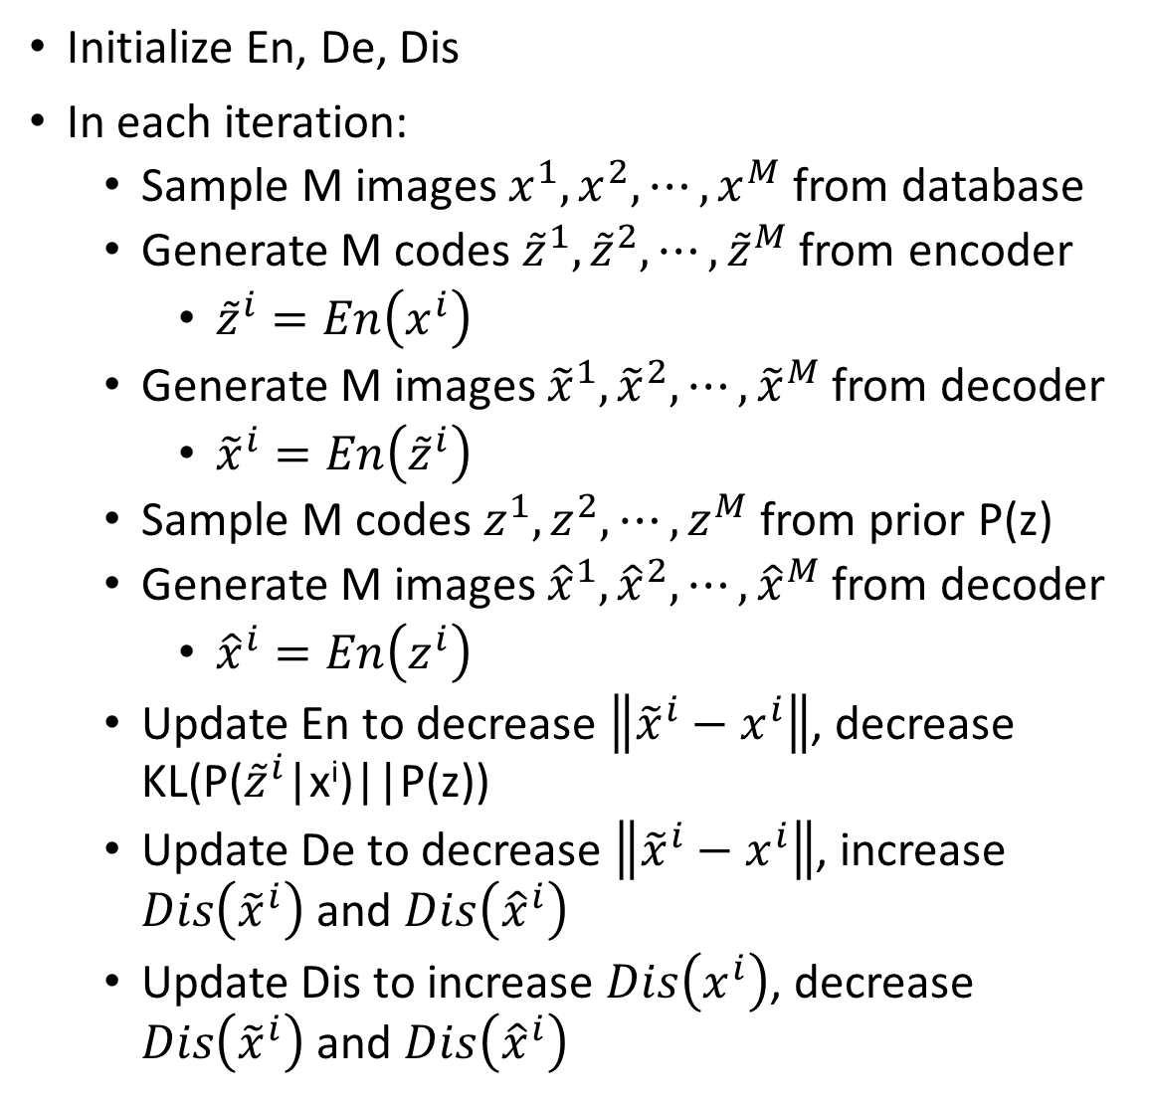
Algorithm
Initialize En, De, Dis
In each iteration:
Sample M images $x^{1},x^{2},⋯,x^{M}$ from database
Generate M codes ${\tilde{z}}^{1},{\tilde{z}}^{2},⋯,{\tilde{z}}^{M}$ from encoder
${\tilde{z}}^{i}=En\left(x^{i}\right)$
Generate M images ${\tilde{x}}^{1},{\tilde{x}}^{2},⋯,{\tilde{x}}^{M}$from decoder
${\tilde{x}}^{i}=En\left({\tilde{z}}^{i}\right)$
Sample M codes $z^{1},z^{2},⋯,z^{M}$ from prior P(z)
Generate M images ${\hat{x}}^{1},{\hat{x}}^{2},⋯,{\hat{x}}^{M}$from decoder
${\hat{x}}^{i}=En\left(z^{i}\right)$
Update En to decrease $\left\|{\tilde{x}}^{i}−x^{i}\right\|$, decrease KL(P(${\tilde{z}}^{i}$|x^{i})||P(z))
Update De to decrease $\left\|{\tilde{x}}^{i}−x^{i}\right\|$, increase $Dis\left({\tilde{x}}^{i}\right)$ and $Dis\left({\hat{x}}^{i}\right)$
Update Dis to increase $Dis\left(x^{i}\right)$, decrease $Dis\left({\tilde{x}}^{i}\right)$ and $Dis\left({\hat{x}}^{i}\right)$
Another kind of discriminator:
real
gen
recon
Discriminator
x

Slide 20
VAE+GAN - Sample
blurry
sharp
sharp

Slide 21
VAE+GAN - Reconstruction
GAN cannot do reconstruction

Slide 22
InfoGAN

Slide 23
What is InfoGAN?
z
z’
Generator
(Decoder)
x
Discriminator
=
scalar
c
Encoder
Parameter
sharing
“Auto-encoder”
(only the last layer is different)
Predict the code c that generates x
c

Slide 24
Motivation
Regular
GAN
z’
Generator
(Decoder)
x
Encoder
c
c
c must have clear influence on x, so the encoder can recover c from x
c will be easy to interpret
A specific dimension c_{i} cannot cooperate with other feature dimensions to have influence.

Slide 29
BiGAN
Jeff Donahue, Philipp Krähenbühl, Trevor Darrell, “Adversarial Feature Learning”, ICLR, 2017
Vincent Dumoulin, Ishmael Belghazi, Ben Poole, Olivier Mastropietro, Alex Lamb, Martin Arjovsky, Aaron Courville, “Adversarially Learned Inference”, ICLR, 2017

Slide 30
BiGAN
(from prior distribution)
from encoder or decoder?
code z
code z
Encoder
Decoder
Discriminator
Image x
Image x
Image x
code z
(real)
(generated)
Notes:
Can I provide the full proof here?
In the end, Bi-GAN = Autoencoder
Different kind of regularization

Slide 31
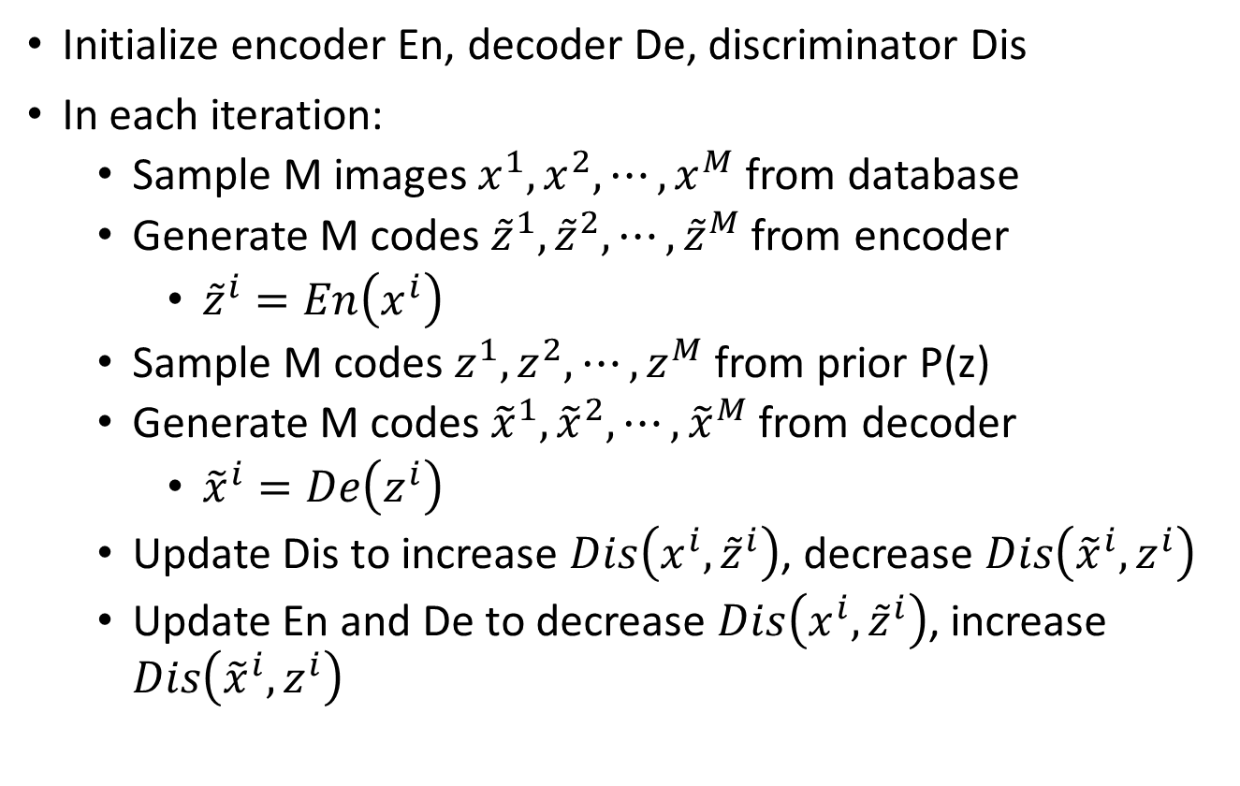
Algorithm
Initialize encoder En, decoder De, discriminator Dis
In each iteration:
Sample M images $x^{1},x^{2},⋯,x^{M}$ from database
Generate M codes ${\tilde{z}}^{1},{\tilde{z}}^{2},⋯,{\tilde{z}}^{M}$ from encoder
${\tilde{z}}^{i}=En\left(x^{i}\right)$
Sample M codes $z^{1},z^{2},⋯,z^{M}$ from prior P(z)
Generate M codes ${\tilde{x}}^{1},{\tilde{x}}^{2},⋯,{\tilde{x}}^{M}$ from decoder
${\tilde{x}}^{i}=De\left(z^{i}\right)$
Update Dis to increase $Dis\left(x^{i},{\tilde{z}}^{i}\right)$, decrease $Dis\left({\tilde{x}}^{i},z^{i}\right)$
Update En and De to decrease $Dis\left(x^{i},{\tilde{z}}^{i}\right)$, increase $Dis\left({\tilde{x}}^{i},z^{i}\right)$
Notes:
Draw en, de jointly

Slide 32
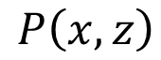
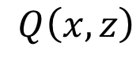
(from prior distribution)
from encoder or decoder?
code z
code z
Encoder
Decoder
Discriminator
Image x
Image x
Image x
code z
(real)
(generated)
Evaluate the difference between P and Q
$$P\left(x,z\right)$$
$$Q\left(x,z\right)$$
To make P and Q the same
Optimal encoder and decoder:
En(x’) = z’
De(z’) = x’
For all x’
De(z’’) = x’’
En(x’’) = z’’
For all z’’
Notes:
有一部分是動不了的
Can I provide the full proof here?
In the end, Bi-GAN = Autoencoder
Different kind of regularization

Slide 33
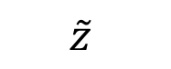
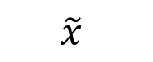
BiGAN
Optimal encoder and decoder:
En(x’) = z’
De(z’) = x’
For all x’
De(z’’) = x’’
En(x’’) = z’’
For all z’’
How about?
$$\tilde{x}$$
$$\tilde{z}$$
Decoder
Encoder
En, De
z
x
Encoder
Decoder
x
En, De
z

Slide 36
Concluding Remarks
GAN+Autoencoder
InfoGAN
BiGAN
Encoder
Generator
(Decoder)
Discriminator
x
z
x
scalar
Generator
(Decoder)
Discriminator
Encoder
z
x
scalar
z
z
Decoder
x
x
Discriminator
scalar
x
Encoder
z
z

Slide 37
Next Time: Energy-based GAN

Slide 38
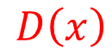
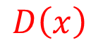
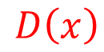
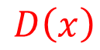
Original Idea
Discriminator
Data (target) distribution
Generated distribution
Discriminator leads the generator
$$D\left(x\right)$$
$$D\left(x\right)$$
$$D\left(x\right)$$
$$D\left(x\right)$$

Slide 39
Original Idea
When the data distribution and generated distribution is the same.
The output of discriminator will be flat everywhere.
However, discriminator is often used in pre-training.
It contains useful information.
We always use the discriminator obtained in the last iteration as the initialization of the next step.

Slide 40
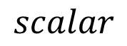
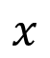
Energy-based Model
We want to find an evaluation function F(x)
Input: object x (e.g. images), output: scalar (how good x is)
Real x has high F(x)
F(x) can be a network
We can find good x by F(x):
Generate x with large F(x)
How to find F(x)?
Evaluation Function
$$x$$
$$scalar$$
F(x)
real data

Slide 41
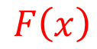
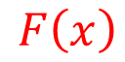
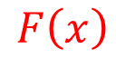
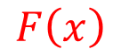
Energy-based GAN
$$F\left(x\right)$$
We want to find an evaluation function F(x)
How to find F(x)?
$$F\left(x\right)$$
In the end ……
$$F\left(x\right)$$
$$F\left(x\right)$$

Slide 42
Energy-based Model
Preview: Framework of structured learning (Energy-based Model)
ML Lecture 21: Structured Learning - Introduction
https://www.youtube.com/watch?v=5OYu0vxXEv8
ML Lecture 22: Structured Learning - Linear Model
https://www.youtube.com/watch?v=HfPw40JPays
ML Lecture 23: Structured Learning - Structured SVM
https://www.youtube.com/watch?v=YjvGVVrCrhQ
ML Lecture 24: Structured Learning - Sequence Labeling
https://www.youtube.com/watch?v=o9FPSqobMys
Graphical model & Gibbs sampling
http://speech.ee.ntu.edu.tw/~tlkagk/courses/MLDS_2015_2/Lecture/MRF%20(v2).ecm.mp4/index.html

